Slide 1
iKnow interconnecting Knowledge (EFP Workshop 26.10.11 - Part 1)
Rafael Popper
rafael.popper@manchester.ac.uk
iKnow Project Director

Slide 2
Researching
Wild Cards
3 broader types of Wild Cards
iKnow assumes that “anything” could be a weak signal… It all depends on the observer’s interpretation:
1. Current Strengths & Weaknesses
2. Current Drivers, Trends & Challenges
3. Current Strategies & Policies
4. Emerging Issues
5. Future Drivers, Scenarios, Threats & Opportunities
6. Shared Visions, Megatrends & Grand Challenges
7. Hidden Issues (Secrets & Unknowns)
8. Past Wild Cards
Researching Weak Signals
8 broader types of Weak Signals
Popper (2011)

Slide 3
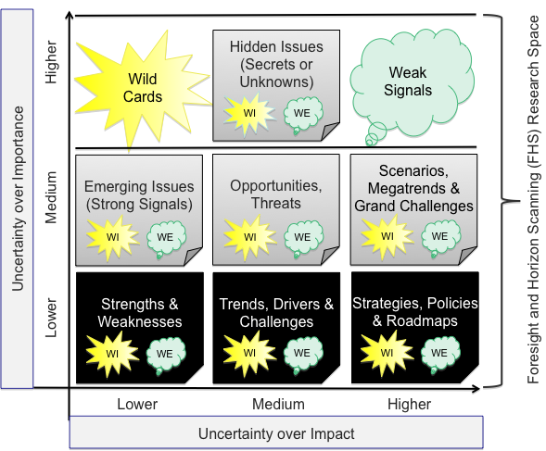
Popper (2011)

Slide 4
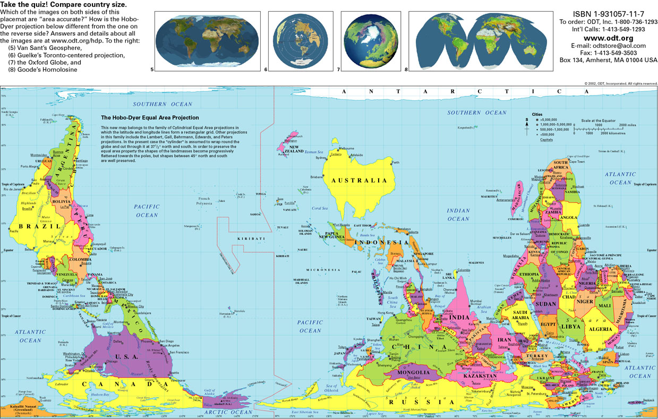
McArthur's Universal Corrective Map of the World
South
North

Slide 5
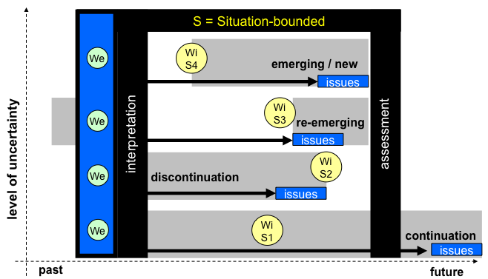
Popper (2011)

Slide 6
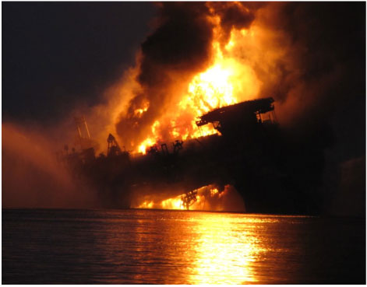
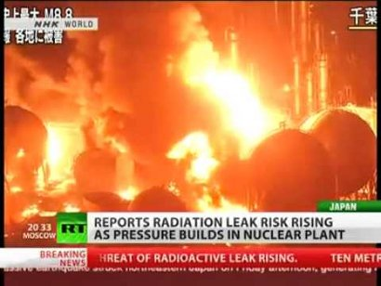
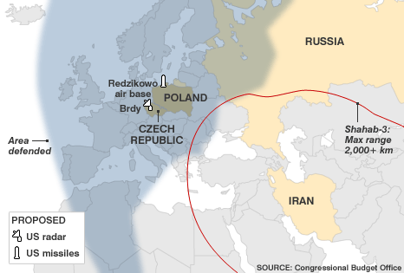
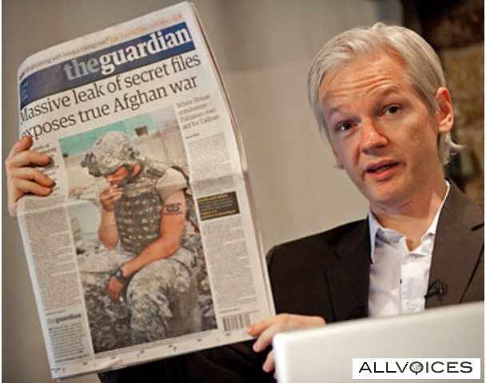
Some examples of
Wild Cards
past wild cards can be weak signals of future events… including new wild cards…
Some examples of Weak Signals
weak signals can hint about potential wild cards…

Slide 7
iKnow interconnecting Knowledge (EFP Workshop 26.10.11 – Part 2)
Rafael Popper
rafael.popper@manchester.ac.uk
iKnow Project Director

Slide 8
New Weak Signals Concept (Popper, 2011)
Weak Signals are ambiguous events, often referred to as “seeds of change”, providing advance intelligence or “hints” about potentially important futures, e.g. Wild Cards, challenges and opportunities. Weak Signals lie in the eye of the beholder and are often influenced by the mental frameworks and subjective interpretations of individuals with limited information about emerging trends, developments or issues in a particular time and context. Their “weakness” is directly proportional to levels of uncertainty about their interpretations, importance and implications in the short-medium-to-long-term. Weak Signals are unclear observables warning us about the possibility of future “game changing” events.
Influenced by
Mental frameworks
Subjective interpretations
Limited information
Time/Context
i3 uncertain issues
Interpretation
Importance
Implications
Pseudo-evidence-based
Unclear observables
Creativity-based
Game changing events

Slide 9
iKnow is 50% Research
Research Agenda
To develop wild cards (WI) research frameworks
To develop weak signals (WE) research frameworks
To develop strategies to scan and assess WIWE
To explore WIWE shaping/shaking ERA & STI policy
To develop ERA toolkit & practical guide to WIWE
iKnow is 50% Technology Development
Technology Development Agenda
To build tools capable of mapping WIWE
To build tools capable of assessing WIWE
To build tools capable of interconnecting WIWE
To build tools capable of interconnecting knowledge
To build tools capable of interconnecting actors

Slide 10
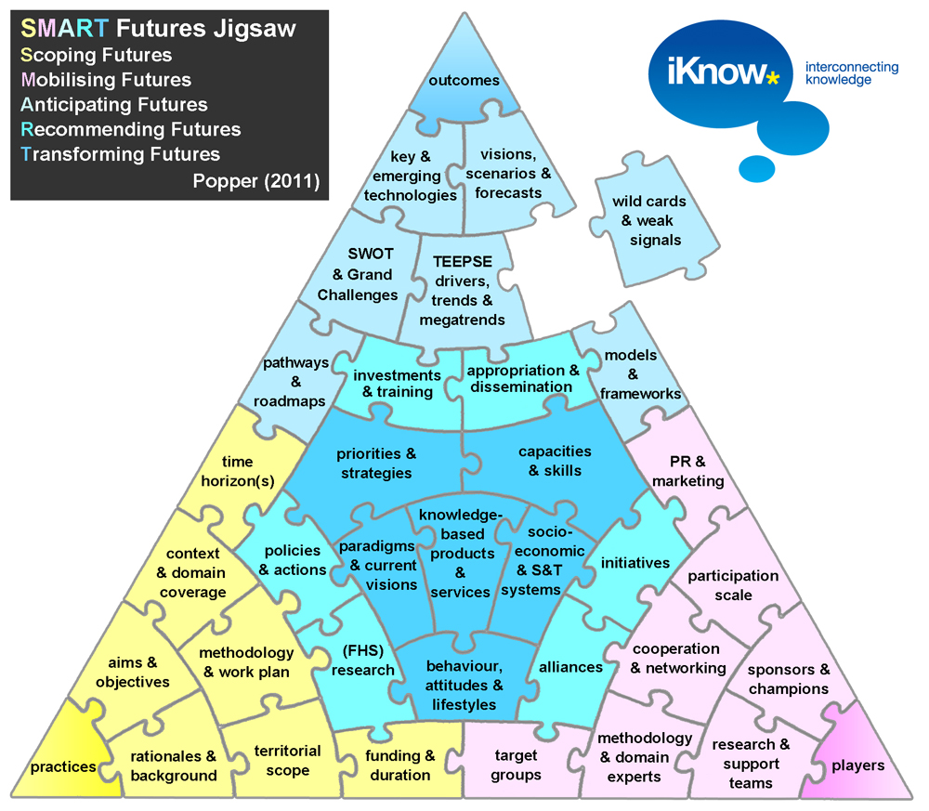
iKnow has positioned Wild Cards &
Weak Signals (WI-WE) studies as a core element in foresight and horizon scanning (FHS) activities

Slide 11
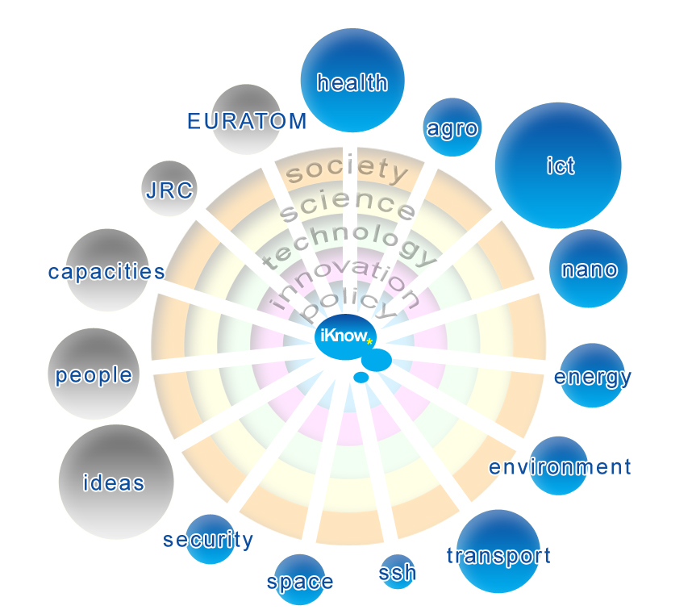
Top-Down
iKnow developed 4 WIWE
scanning strategies
Horizon Scanning
Strategy 1
ILTD
Horizon Scanning
Strategy 2
OLTD
Inward-Looking
Outward-Looking
Horizon Scanning
Strategy 3
ILBU
Horizon Scanning
Strategy 4
OLBU
Bottom-Up
Popper (2011)

Slide 12
Popper (2011)

Slide 13
Mapping Wild Cards
Mapping Weak Signals
Nomination
source
theme
sub-theme
references
short name / headline
Abstract
likelihood
Description
typology
importance
Analysis
early indicators
main drivers
risks & opportunities
stakeholders’ actions
Interconnection
Grand Challenges
thematic relevance
ERA relevance
relevant research-friendly strategies
RTD & STI policy relevance
Nomination
source
theme
sub-theme
references
short name / headline
abstract
Description
manifestation
potential implications
importance
Analysis
filters
main drivers
risks & opportunities
stakeholders’ actions
Interconnection
Grand Challenges
thematic relevance
ERA relevance
relevant research-friendly strategies
RTD & STI policy relevance

Slide 14
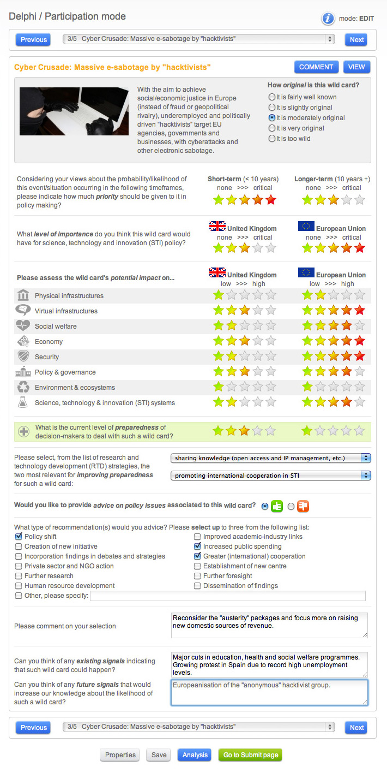
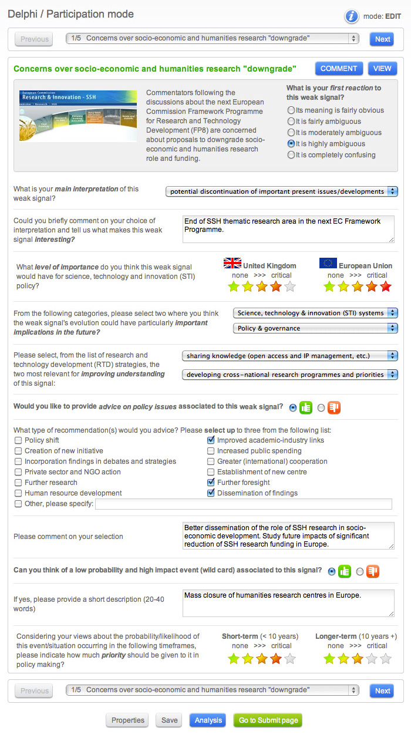
Wild Cards Delphi
Weak Signals Delphi
120 selected WIWE
assessed by
700+ participants

Slide 15
Wild Cards Delphi
60
Wild Cards
So far we have…
~4000
assessments
Wild Cards headline navigation panel
Comments & full preview
Description & Originality
Short- & Long-term priority for policymaking
Importance for STI policy in Your Country & EU
Potential
impacts on
(in Your Country
& the EU)
1- Physical infrastructure
2 - Virtual infrastructure
3 - Social welfare
4 - Economy
5 - Security
6 - Policy & governance
7 - Environment & ecosystems
8 - STI systems
Preparedness
ERA relevance
Policy advice
Current signals indicating WI plausibility
Future signals indicating WI plausibility
Wild Cards headline navigation panel
Analysis & Submission panels

Slide 16
Weak Signals Delphi
60
Weak Signals
So far we have…
2500+
assessments
Wild Cards headline navigation panel
Comments & full preview
Description & Ambiguity
Main interpretation
Comment on interpretation
STI Importance
in Your Country & EU
1- Physical infrastructure
2 - Virtual infrastructure
3 - Social welfare
4 - Economy
5 - Security
6 - Policy & governance
7 - Environment & ecosystems
8 - STI systems
Impact areas
ERA relevance
Policy advice
Potential wild card
Short- & Long-term priority for policymaking
Wild Cards headline navigation panel
Analysis & Submission panels

Slide 17
Delphi results on September 2011
60
60
900+ ISSUES.
Key facts and figures
4000+ assessments to
60
Wild Cards
2500+ assessments to
60 Weak Signals

Slide 18
50%
match
Wild Cards
CAP | Universities close as research does not meet the needs of industry
NUC | Severe accident of a nuclear power plant
SSH | Soft "EuroLanding" or "Happy End" in EuroLand
AGR | Silent Seas
CAP | European Commission scrap research support projects
NUC | A considerable increase in efficiency of renewable resources
SSH | Cyber Crusade: Massive e-sabotage by "hacktivists"
AGR | A Killer Water Filter
ICT | Secure and safe internet that is easy to use
ENV | Risk assessment "saves" millions of lives but…
Wild Cards for UK
ICT | Information crisis caused by personalized information delivery
ENE | Breakthrough in cold fusion leads to renaissance in energy markets
ICT | Secure and safe internet that is easy to use
ENE | Gas from Trash
SSH | Cyber Crusade: Massive e-sabotage by "hacktivists"
CAP | Universities close as research does not meet the needs of industry
ICT | Nano-lab inside your body
HEA | End of Ageing
CAP | European Commission scrap research support projects
SSH | Soft "EuroLanding" or "Happy End" in EuroLand

Slide 19
30%
match
Wild Cards for
STI
CAP | Universities close as research does not meet the needs of industry
CAP | European Commission scrap research support projects
NUC | Severe accident of a nuclear power plant
NUC | A considerable increase in efficiency of renewable resources
AGR | Silent Seas
SPA | Space war
SPA | Revolutionary space propulsion technology
SSH | Soft "EuroLanding" or "Happy End" in EuroLand
SSH | Cyber Crusade: Massive e-sabotage by "hacktivists"
HEA | End of Ageing
Wild Cards for UK
STI
ENE | Breakthrough in cold fusion leads to renaissance in energy markets
CAP | Universities close as research does not meet the needs of industry
ICT | Information crisis caused by personalized information delivery
ICT | Nano-lab inside your body
CAP | Scientists up for murder as ethical issues for research are abolished
CAP | European Commission scrap research support projects
ENE | Gas from Trash
SSH | Automatic learning through neuro-data transfer
ICT | Secure and safe internet that is easy to use
HEA | End of Ageing

Slide 20
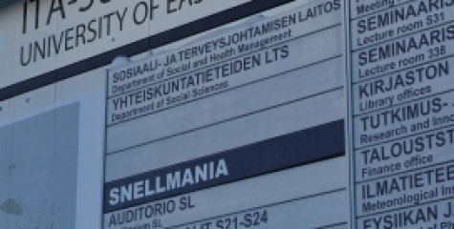
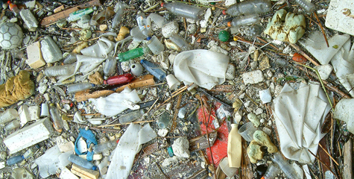
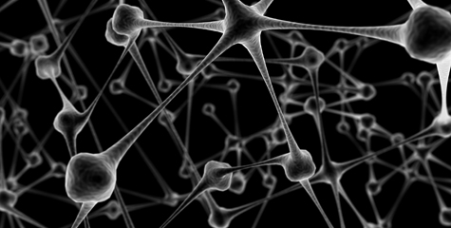
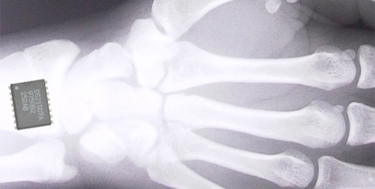
Top 10
Wild Cards for UK STI
Breakthrough in cold fusion leads to renaissance in energy markets
European Commission scrap research support projects
Universities close as research does not meet the needs of industry
Gas from Trash
Information crisis caused by personalized information delivery
Automatic learning through neuro-data transfer
Nano-lab inside your body
Secure and safe internet that is easy to use
Scientists up for murder as ethical issues for research are abolished
End of Ageing

Slide 21
Ph-I
Vi-I
Sec
Env
SoW
Eco
Pol
STI
Sec
Env
STI
STI
Eco
Eco
SoW
Vi-I
Sec
Vi-I
STI
Sec
Pol
STI
Vi-I
SoW
STI
Eco
Sec
Eco
Env
STI
Sec
Pol
Pol
STI
Popper (2011)

Slide 22
40%
match
Weak Signals
CAP | Lack of interest in science by young scholars
AGR | Emergence of new agricultural methods for coping with climate change
CAP | Administration rather than results a priority
SEC | No strict global rules on nuclear security
NUC | Development of new materials
ENV | Growing frequency of floods in Europe and the world
SPA | Privatisation of space flights
NAN | Implantable electronics leaving no trace
SSH | Concerns over socio-economic and humanities research "downgrade"
NUC | Small-scale nuclear power plant operating
Top 10
Weak Signals for
UK
CAP | Lack of interest in science by young scholars
CAP | Administration rather than results a priority
SEC | No strict global rules on nuclear security
ICT | Next generation peer-to-peer content delivery platform
ENV | Growing frequency of floods in Europe and the world
ICT | Fast electronics for compact lab-on-chip applications
AGR | Bees be no more, less food than before
ENV | Growing environmental legal class actions on no-win no-fee basis
ENV | Emergence of secondary carbon financial vehicles
HEA | Increasing Self-Medication

Slide 23
40%
match
Weak Signals for
STI
CAP | Lack of interest in science by young scholars
SPA | Optical lifting demonstrated for the first time
CAP | Administration rather than results a priority
SSH | Growing interest in wild cards and weak signals research
CAP | Growing efforts to assist SMEs to exploit R&D collaborative projects
SPA | Ideas for radically new ways to reach Space
NAN | Herbs (enhanced by Nanotechnology) used to fight cancer
SPA | Privatisation of space flights
NAN | Implantable electronics leaving no trace
NUC | Development of new materials
Top 10 Weak Signals for UK
STI
HEA | Neuro-Enhancement
ICT | Fast electronics for compact lab-on-chip applications
SSH | Growing interest in wild cards and weak signals research
CAP | Lack of interest in science by young scholars
CAP | Administration rather than results a priority
CAP | Growing efforts to assist SMEs to exploit R&D collaborative projects
HEA | Increasing Self-Medication
ICT | Migration of internet services in pervasive ICT environment
ICT | Next generation peer-to-peer content delivery platform
ENV | Growing frequency of floods in Europe and the world

Slide 24
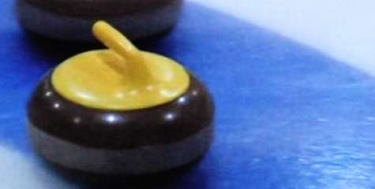
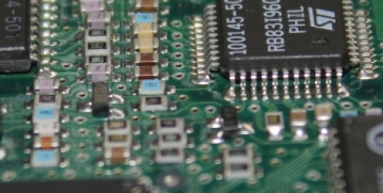
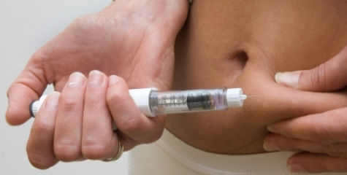
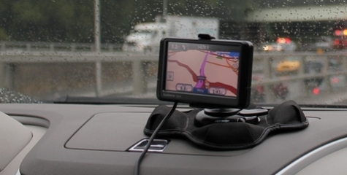
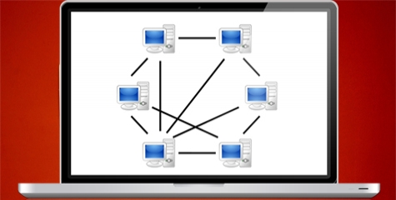
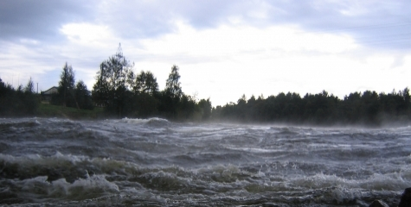
Top 10
Weak Signals for UK STI
Neuro-Enhancement
Growing efforts to assist SMEs to exploit R&D collaborative projects
Fast electronics for compact lab-on-chip applications
Increasing Self-Medication
Growing interest in wild cards and weak signals research
Migration of internet services in pervasive ICT environment
Lack of interest in science by young scholars
Next generation peer-to-peer content delivery platform
Administration rather than results a priority
Growing frequency of floods in Europe and the world

Slide 26
STI
Pol
Eco
Pol
STI
Env
Ph-I
SoW
SoW
Pol
Eco
STI
Pol
Eco
Vi-I
STI
SoW
Eco
STI
Vi-I
Sec
STI
Popper (2011)

Slide 27
iKnow Project & Tools
(R + TD Agenda)
iOracle
(Mapping)
iLibrary
(interconnecting, sharing and managing knowledge)
iCommunity
(Networking)
iScan
(Advanced WI-WE monitoring)
iBank
(Knowledge generation and WI-WE mapping)
iDelphi
(Participatory WI-WE assessment)
iNews
(Dissemination)

